Slide 1
Deep Neural Networks And Where to Find Them
Artem Korenev, Nikita Gryaznov
Skoltech ISP, 2018

Slide 2
Welcome
Hi everybody!
Two TAs: Artem and Nikita (2nd year MSc students)
6 days in-class (~20 hours)
40 hours for the course in total
Other time for HW and self education
If you don’t get something – you are very welcome to ask a question right away
Don’t be shy and come after lecture if you need

Slide 3
What the Course is About
Introduction in Deep Neural Networks and how to use them
This is mostly an introductory course (your first starting point in DL)
We aim on people outside IT track
Bias towards practice instead of theory
We will use Keras library (not Tensorflow, not Theano, not PyTorch)
Currently, we are not going to even briefly touch things like GAN, RNN, Reinforcement Learning, Segmentation and Detection
If you are an advanced student and still want to learn DL further please come forward and we will discuss what you can do individually

Slide 4
Syllabus*
Days:
ML introduction. Logistic regression. Neural networks approach.
Matrix representation of neural networks. Details of NNs optimization.
Activation functions. Loss functions. Regression problem.
Different optimizers. Regularization.
Convolutional Neural Networks basics
Practical tricks and consultation.
+ Daily seminars and exercises climaxing with a final homework assignment
* Subject to change depending on the pace

Slide 5
Requirements for the Course
Basic proficiency in Python
Simple math knowledge (matrices, derivatives)
Having a laptop
None of this is absolutely mandatory but will help you understand many things
Let’s have a quiz everybody: https://goo.gl/ZTXf3v

Slide 6
Why Bother?
A Couple of Words About Machine Learning

Slide 7
Machine Learning in 2018
The sexiest job of the 21st century
Creating programs from data
Field has a lot of algorithms (kNN, decision trees, SVM, etc.)
Neural Networks is just one of them
NNs are growing crazy since 2012
NNs are everywhere
Let’s see some examples…

Slide 8
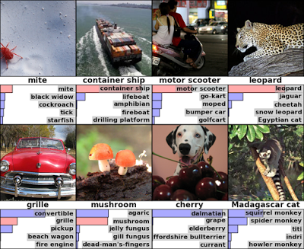
Image classification
ImageNet Challenge, 2012

Slide 9
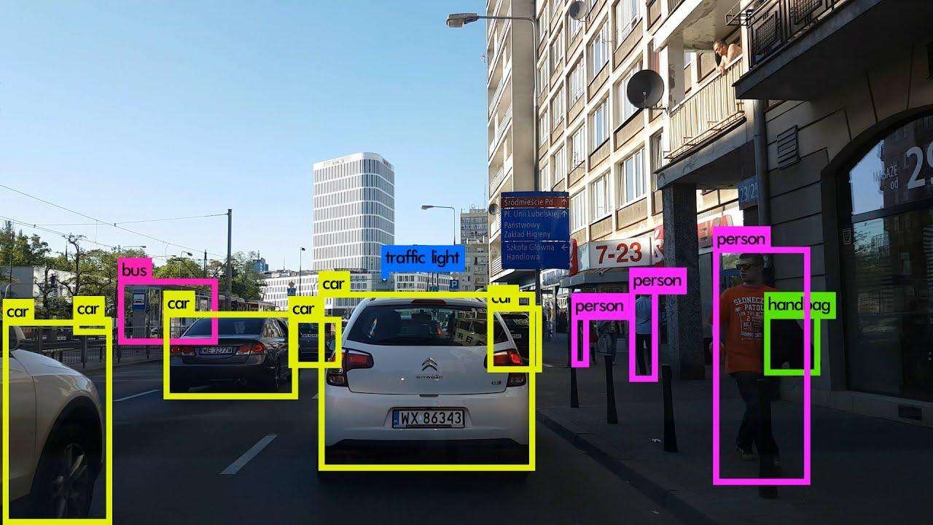
Object Detection
https://www.youtube.com/watch?v=VOC3huqHrss

Slide 10
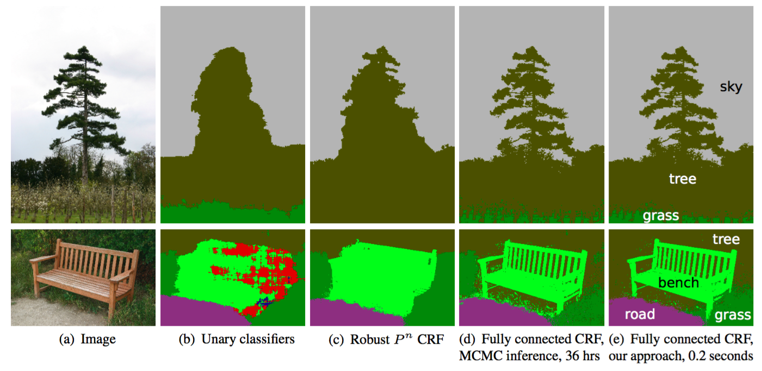
Image Segmentation

Slide 11
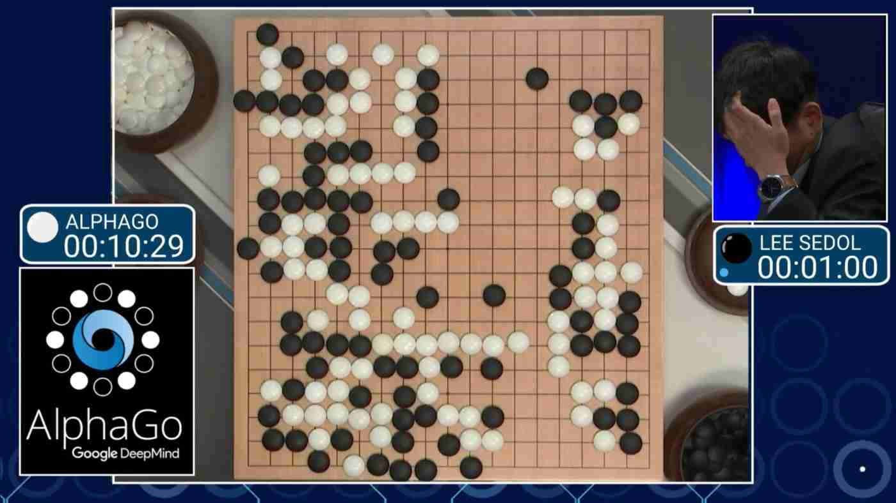
AlphaGo

Slide 12
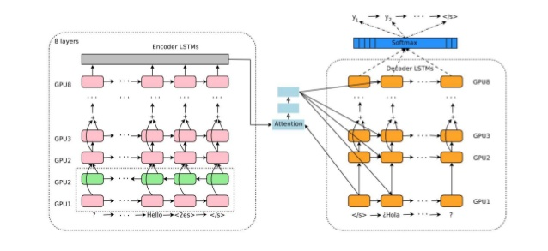
Machine Translation

Slide 13

Prisma App

Slide 14
Demos
http://make.girls.moe/
https://www.youtube.com/watch?v=9reHvktowLY
https://affinelayer.com/pixsrv/
https://www.youtube.com/watch?v=DgPaCWJL7XI
https://google.github.io/tacotron/publications/tacotron2/index.html
http://www.aiva.ai/
And many more

Slide 15
Machine Learning Algorithms
How they (usually) work

Slide 16
Machine Learning Algorithms
We create a box that has needed input and output (called model)
For classification problem, for example, an image and the number of a class
We design a function that measures badness of this black box (called loss function)
Given data we try to tweak or model to achieve the minimal score for loss function

Slide 17
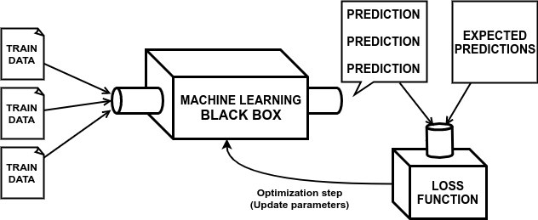
Machine Learning Algorithms

Slide 18
Machine Learning Algorithms
Our Model

Slide 19
Machine Learning Algorithms
Model Output
Our Model

Slide 20
Machine Learning Algorithms
Model Output
Our Model
Computing badness of the model

Slide 21
Machine Learning Algorithms
Model Output
Our Model
Changing the model slightly to make it better
Computing badness of the model

Slide 22
Neural Network as a ML Black Box
Neural Network

Slide 23
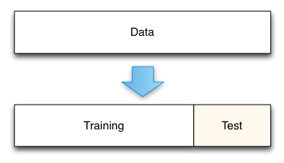
A Bit About Data
To train a model we use data
Models sometimes become really complex so they just memorize dataset instead of generalizing the problem
To spot this we perform splitting data to training and testing data
We train model using training data and measure score on testing data

Slide 24
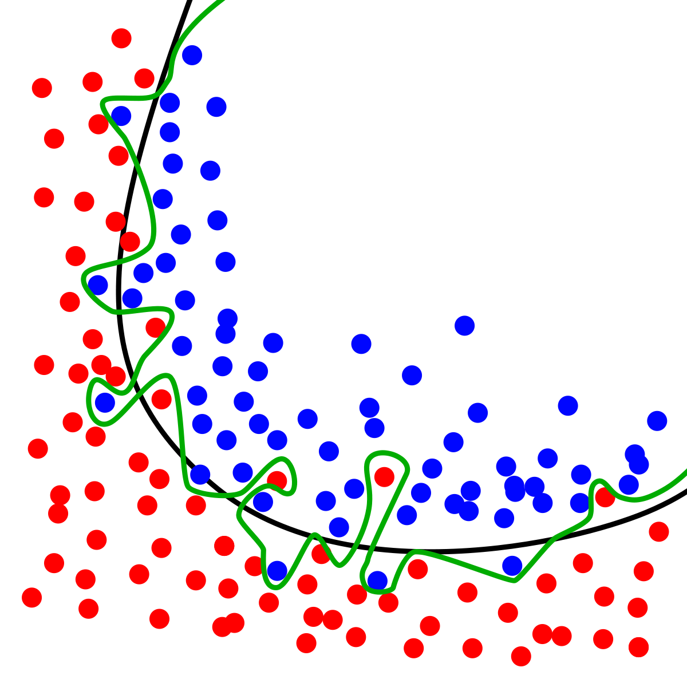
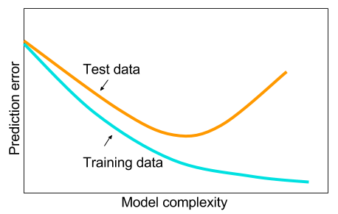
Overfitting

Slide 25
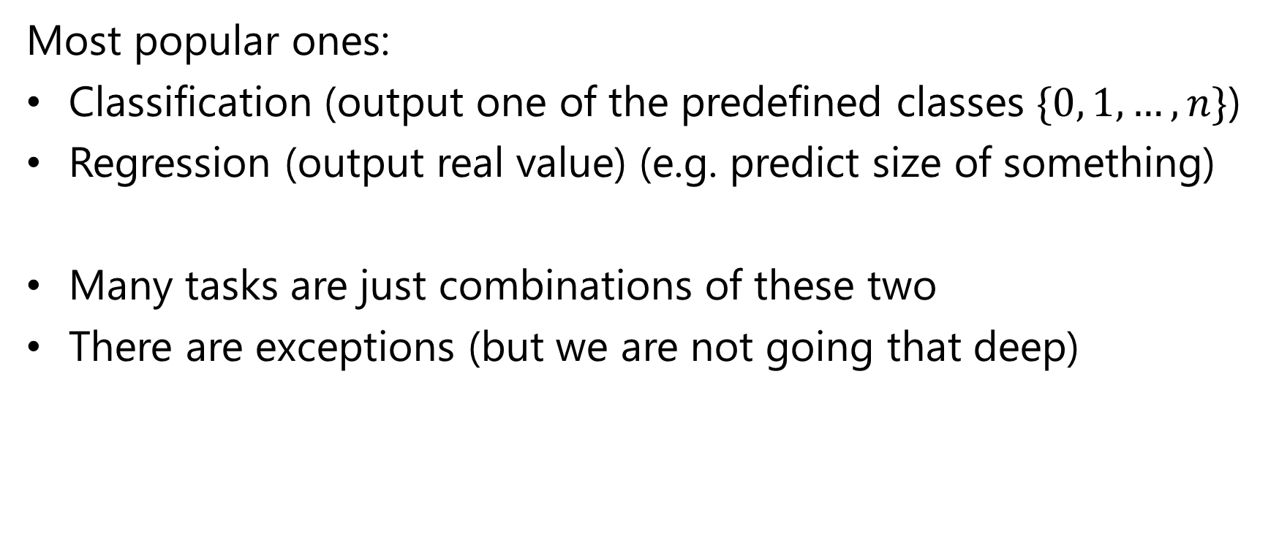
What Types of Problems Can NNs Solve?
Most popular ones:
Classification (output one of the predefined classes $\{0, 1, …, n\}$)
Regression (output real value) (e.g. predict size of something)
Many tasks are just combinations of these two
There are exceptions (but we are not going that deep)

Slide 26
Logistic Regression Algorithm

Slide 27
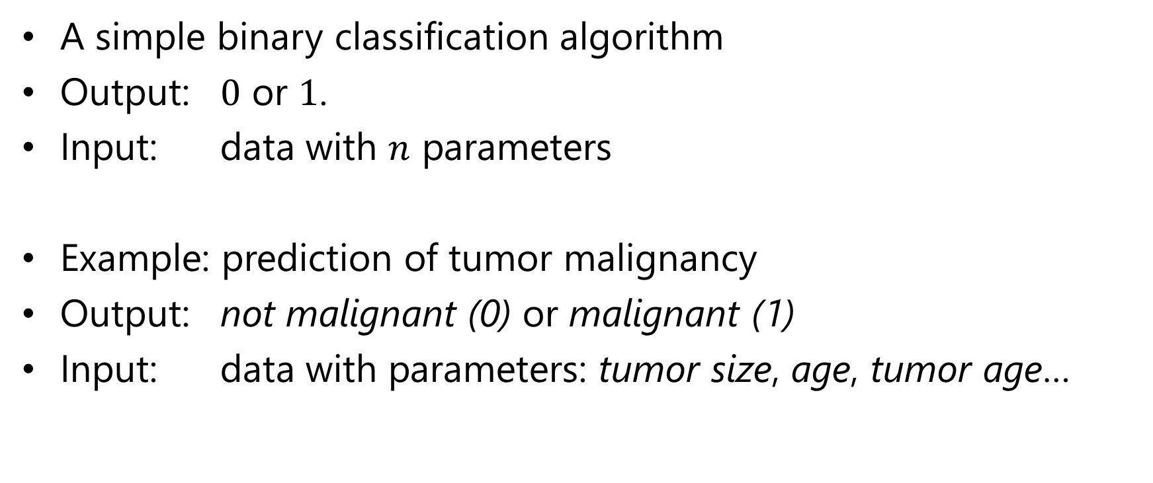
Logistic Regression
A simple binary classification algorithm
Output: $0$ or $1$.
Input: data with $n$ parameters
Example: prediction of tumor malignancy
Output: not malignant (0) or malignant (1)
Input: data with parameters: tumor size, age, tumor age…

Slide 28
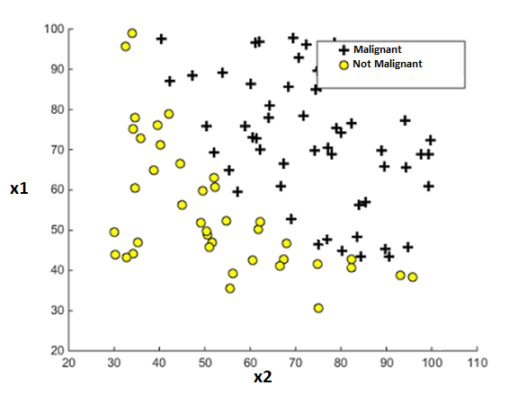
Linear Data Separation

Slide 29
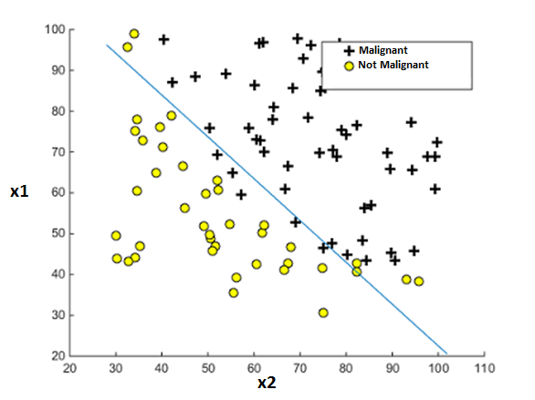
Linear Data Separation
Separating data with a line

Slide 30
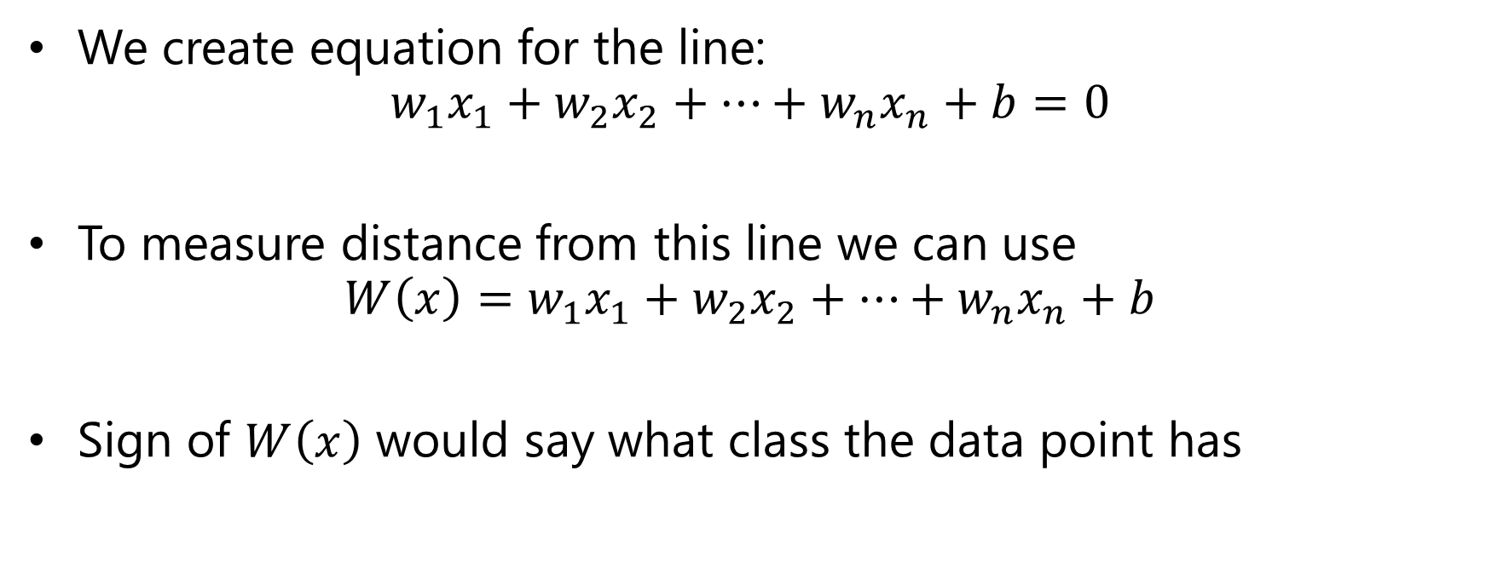
Linear Data Separation
We create equation for the line:
$$w_{1}x_{1}+w_{2}x_{2}+…+w_{n}x_{n}+b=0$$
To measure distance from this line we can use
$$W\left(x\right)=w_{1}x_{1}+w_{2}x_{2}+…+w_{n}x_{n}+b$$
Sign of $W\left(x\right)$ would say what class the data point has

Slide 31
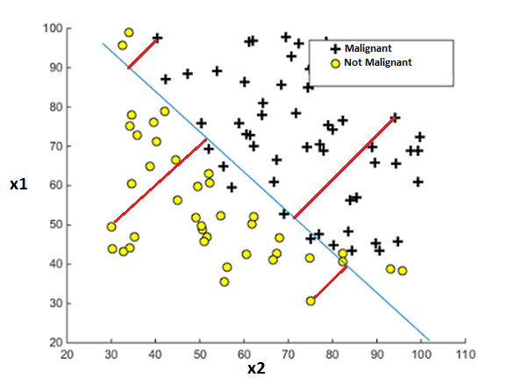
Linear Data Separation
Small Positive Value
Big Positive Value
Big Negative Value
Small Negative Value

Slide 32
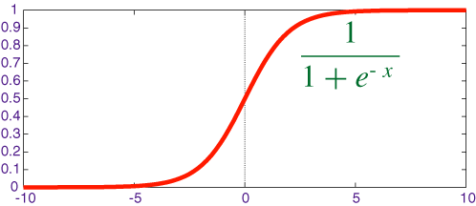

Linear Data Separation
We can transform distance from the line to probability of a data point having a positive class
We can use sigmoid function to do that
$σ\left(x\right)=\frac{1}{1+e^{−x}}$

Slide 33
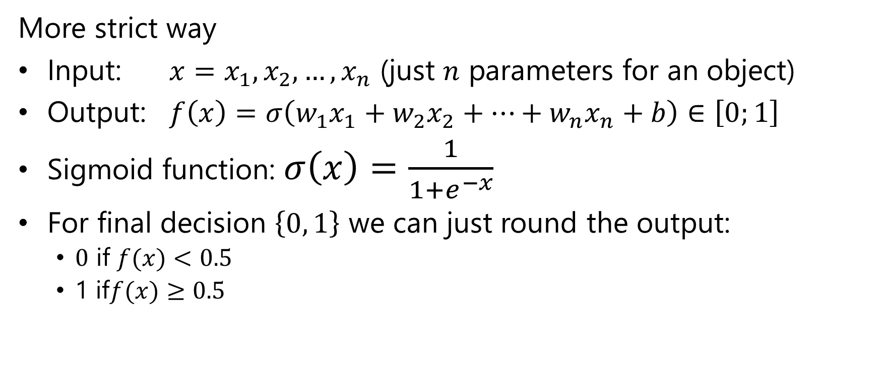
Logistic Regression
More strict way
Input: ${x=x}_{1}, x_{2}, …, x_{n}$ (just $n$ parameters for an object)
Output: $f\left(x\right)=σ\left(w_{1}x_{1}+w_{2}x_{2}+…+w_{n}x_{n}+b\right)∈\left[0;1\right]$
Sigmoid function: $σ\left(x\right)=\frac{1}{1+e^{−x}}$
For final decision $\left\{0, 1\right\}$ we can just round the output:
$0$ if $f(x)<0.5$
1 if$f(x)≥0.5$

Slide 34
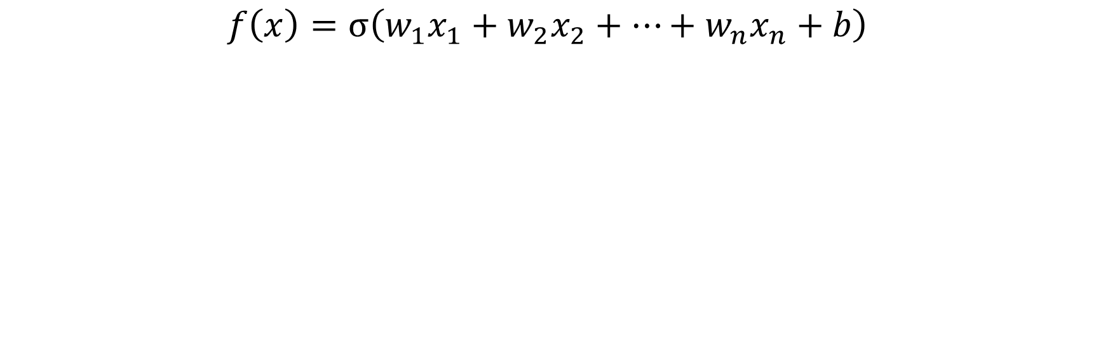
Logistic Regression – Closer Look
Input Data Parameters (tumor size, age, …)
Sigmoid Function
$$f\left(x\right)=σ\left(w_{1}x_{1}+w_{2}x_{2}+…+w_{n}x_{n}+b\right)$$
This special weight is called bias
Learned parameters of the models (so called weights)

Slide 35
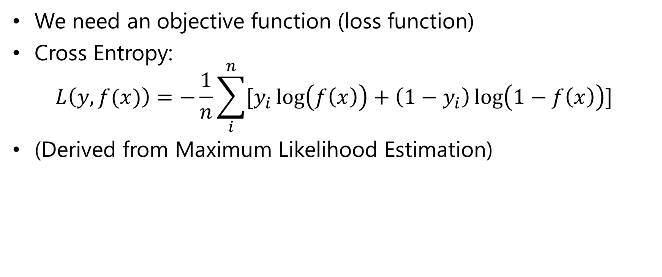
How Do Measure Badness?
We need an objective function (loss function)
Cross Entropy:
$$L\left(y,f(x)\right)=−\frac{1}{n}\sum_{i}^{n}{[y_{i}\log\left(f\left(x\right)\right)+\left(1−y_{i}\right)\log\left(1−f\left(x\right)\right)]}$$
(Derived from Maximum Likelihood Estimation)

Slide 36

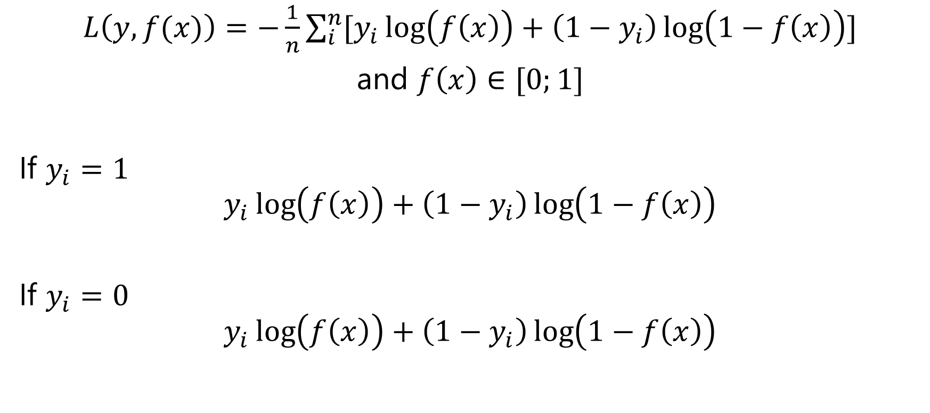

Looking Closer on the Objective
$L\left(y,f(x)\right)=−\frac{1}{n}\sum_{i}^{n}{[y_{i}\log\left(f\left(x\right)\right)+\left(1−y_{i}\right)\log\left(1−f\left(x\right)\right)]}$
and $f\left(x\right)∈[0;1]$
If $y_{i}=1$
$$y_{i}\log\left(f\left(x\right)\right)+\left(1−y_{i}\right)\log\left(1−f\left(x\right)\right)$$
If $y_{i}=0$
$$y_{i}\log\left(f\left(x\right)\right)+\left(1−y_{i}\right)\log\left(1−f\left(x\right)\right)$$
$f(x)$ better be close to $1$
1
0
0
1
$f(x)$ better be close to $0$

Slide 37
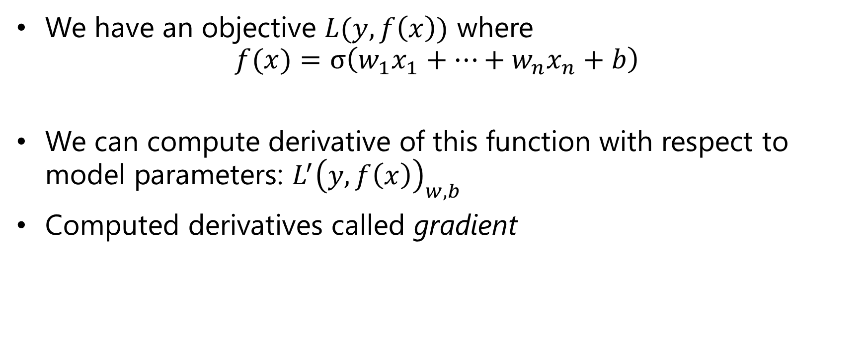
How Do We Optimize This?
We have an objective $L(y, f\left(x\right))$ where
$$f(x)=σ\left(w_{1}x_{1}+…+w_{n}x_{n}+b\right)$$
We can compute derivative of this function with respect to model parameters: $L^{′}{\left(y,f\left(x\right)\right)}_{w,b}$
Computed derivatives called gradient

Slide 38
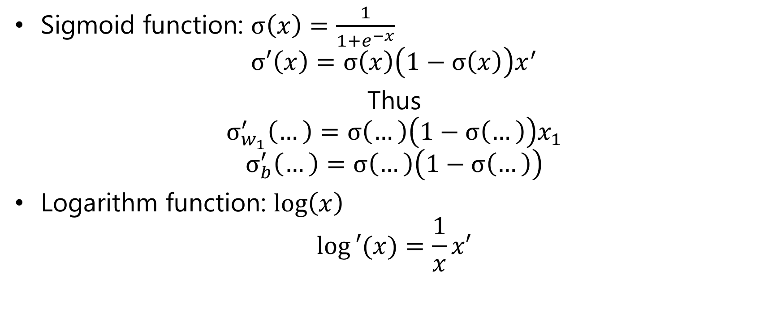
Computing Derivatives
Sigmoid function: $σ\left(x\right)=\frac{1}{1+e^{−x}}$
$$σ′\left(x\right)=σ\left(x\right)\left(1−σ\left(x\right)\right)x^{′}$$
Thus
$$σ_{w_{1}}^{′}\left(…\right)=σ\left(…\right)\left(1−σ\left(…\right)\right)x_{1}$$
$$σ_{b}^{′}\left(…\right)=σ\left(…\right)\left(1−σ\left(…\right)\right)$$
Logarithm function: $\log\left(x\right)$
$$log⁡′(x)=\frac{1}{x}x′$$

Slide 39
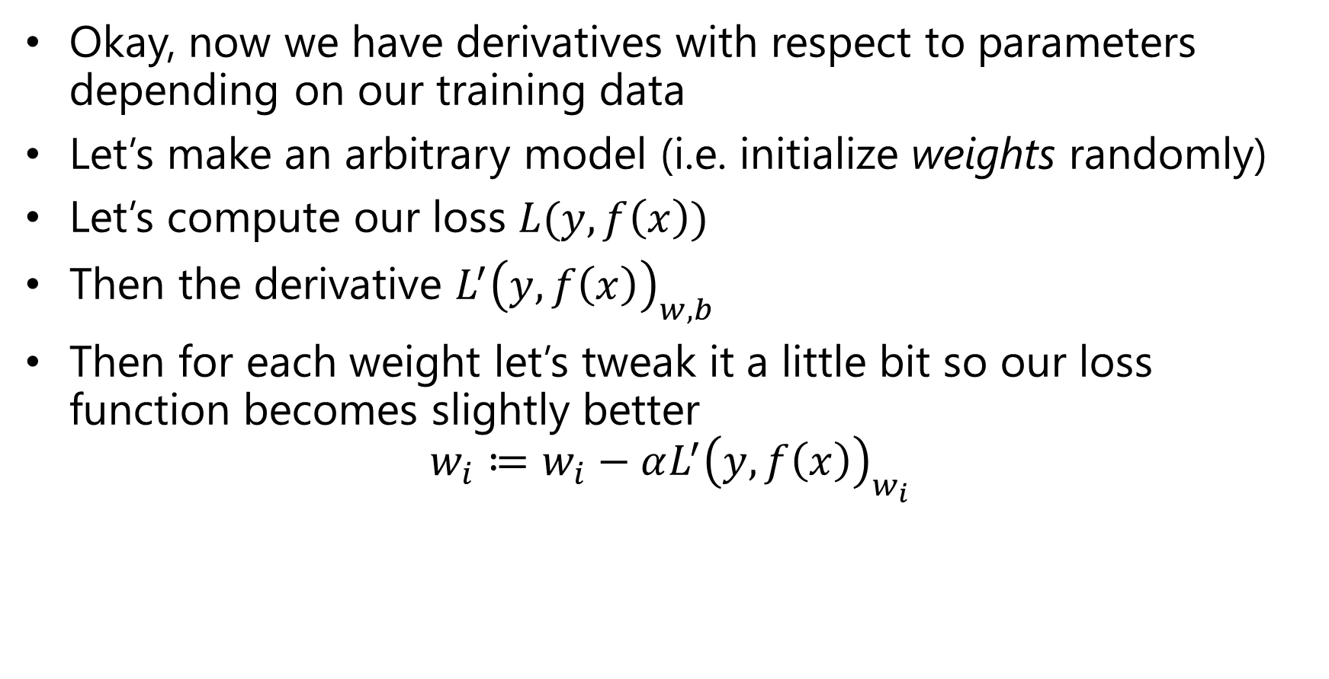
Optimization Procedure
Okay, now we have derivatives with respect to parameters depending on our training data
Let’s make an arbitrary model (i.e. initialize weights randomly)
Let’s compute our loss $L(y,f\left(x\right))$
Then the derivative $L^{′}{\left(y,f\left(x\right)\right)}_{w,b}$
Then for each weight let’s tweak it a little bit so our loss function becomes slightly better
$$w_{i}≔w_{i}−αL^{′}{\left(y,f\left(x\right)\right)}_{w_{i}}$$
Learning rate – how strong should be an optimization step

Slide 40
Optimization Procedure
Compute loss
Compute the gradient for this loss w.r.t. the model parameters
Update the model a little bit towards gradients
Go to 1
This is called gradient descent

Slide 41
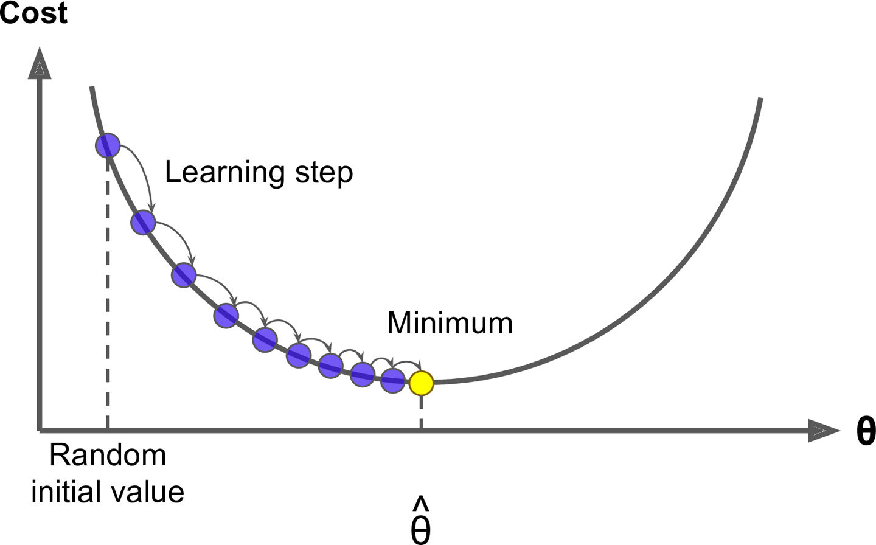
Gradient Descent Intuition

Slide 42
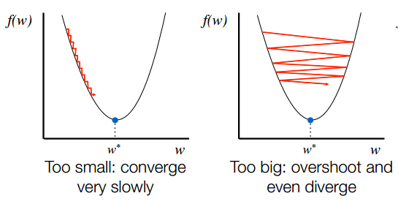
Learning Rate
Learning rate is a parameter you need to adjust wisely

Slide 43
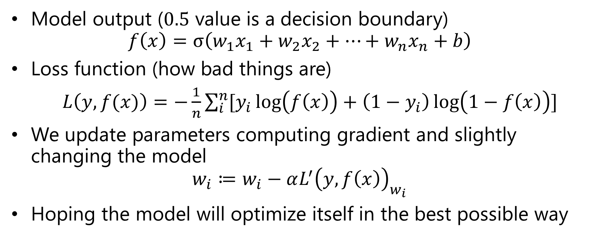
Logistic Regression Recap
Model output ($0.5$ value is a decision boundary)
$$f\left(x\right)=σ\left(w_{1}x_{1}+w_{2}x_{2}+…+w_{n}x_{n}+b\right)$$
Loss function (how bad things are)
$L\left(y,f(x)\right)=−\frac{1}{n}\sum_{i}^{n}{[y_{i}\log\left(f\left(x\right)\right)+\left(1−y_{i}\right)\log\left(1−f\left(x\right)\right)]}$
We update parameters computing gradient and slightly changing the model
$$w_{i}≔w_{i}−αL^{′}{\left(y,f\left(x\right)\right)}_{w_{i}}$$
Hoping the model will optimize itself in the best possible way

Slide 44
Our Scheme

Slide 45
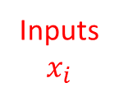
Our Scheme
Inputs
$$x_{i}$$

Slide 46
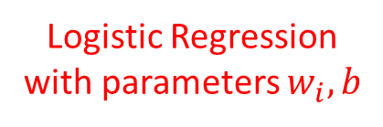
Our Scheme
Logistic Regression with parameters $w_{i}, b$
Inputs
$$x_{i}$$

Slide 47
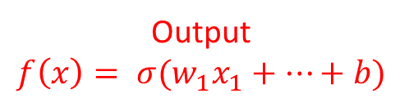
Our Scheme
Output
$$f\left(x\right)= σ(w_{1}x_{1}+…+b)$$
Logistic Regression with parameters $w_{i}, b$
Inputs
$$x_{i}$$

Slide 48
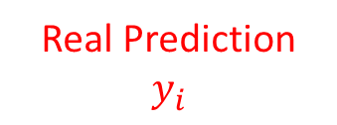
Our Scheme
Output
$$f\left(x\right)= σ(w_{1}x_{1}+…+b)$$
Logistic Regression with parameters $w_{i}, b$
Real Prediction
$$y_{i}$$
Inputs
$$x_{i}$$

Slide 49
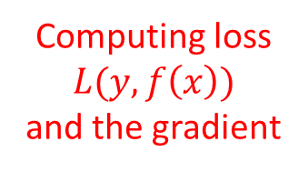
Our Scheme
Output
$$f\left(x\right)= σ(w_{1}x_{1}+…+b)$$
Logistic Regression with parameters $w_{i}, b$
Real Prediction
$$y_{i}$$
Inputs
$$x_{i}$$
Computing loss $L(y, f\left(x\right))$
and the gradient

Slide 50
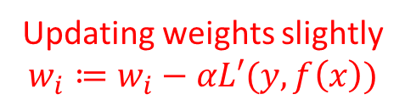
Our Scheme
Output
$$f\left(x\right)= σ(w_{1}x_{1}+…+b)$$
Logistic Regression with parameters $w_{i}, b$
Real Prediction
$$y_{i}$$
Inputs
$$x_{i}$$
Updating weights slightly
$$w_{i}≔w_{i}−αL′(y,f\left(x\right))$$
Computing loss $L(y, f\left(x\right))$
and the gradient

Slide 51




Logistic Regression Scheme
$$σ$$
$$w_{1}x_{1}+…+b$$
$$w_{i}$$
Inputs
$$x_{i}$$

Slide 52


Logistic Regression as a 1-layer NN
Layer
Outputs
$$σ$$
Layer Nonlinearity
or
Activation function
$$w_{1}x_{1}+…+b$$
$$w_{i}$$
Inputs
$$x_{i}$$

Slide 53




Multi-output Layer
Layer
Outputs
(also called neurons)
$$σ$$
$$σ$$
$$σ$$
$$w_{ij}$$
Inputs
$$x_{i}$$

Slide 54




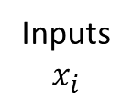


Layers as Blocks
Layer 1
Layer 2
$$σ$$
Outputs
$$σ$$
$$σ$$
$$σ$$
$$w_{2i}$$
$$w_{1ij}$$
Inputs
$$x_{i}$$

Slide 55







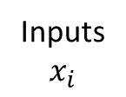



Layers as Blocks
Layer 1
Layer 2
Layer 3
$$σ$$
$$σ$$
Outputs
$$σ$$
$$σ$$
$$σ$$
$$σ$$
$$σ$$
$$w_{3i}$$
$$w_{2ij}$$
$$w_{1ij}$$
Inputs
$$x_{i}$$

Slide 56
Neural Networks
You can stack many layers with various size of outputs together to achieve more complex models
Don’t forget about non-linearity at the end of the layers (this is crucial)
The deeper network – the more complex features layers can learn

Slide 57
Lecture Recap
ML is really powerful nowadays and grows rapidly
Splitting data into train and validation subsets to control overfitting
Logistic Regression learns to separate data with a line (or a plane)
Optimization of Logistic Regression with gradient descent
Picking learning rate carefully
Logistic Regression is a 1-layer Neural Network
You can stack multiple layers to get deeper and more effective NNs

Slide 58
This is it for the first lecture

